Slide 1
FortPrkt

Slide 2
Unreal Engine

Slide 3
Related Work auch hier behandeln???

Slide 4
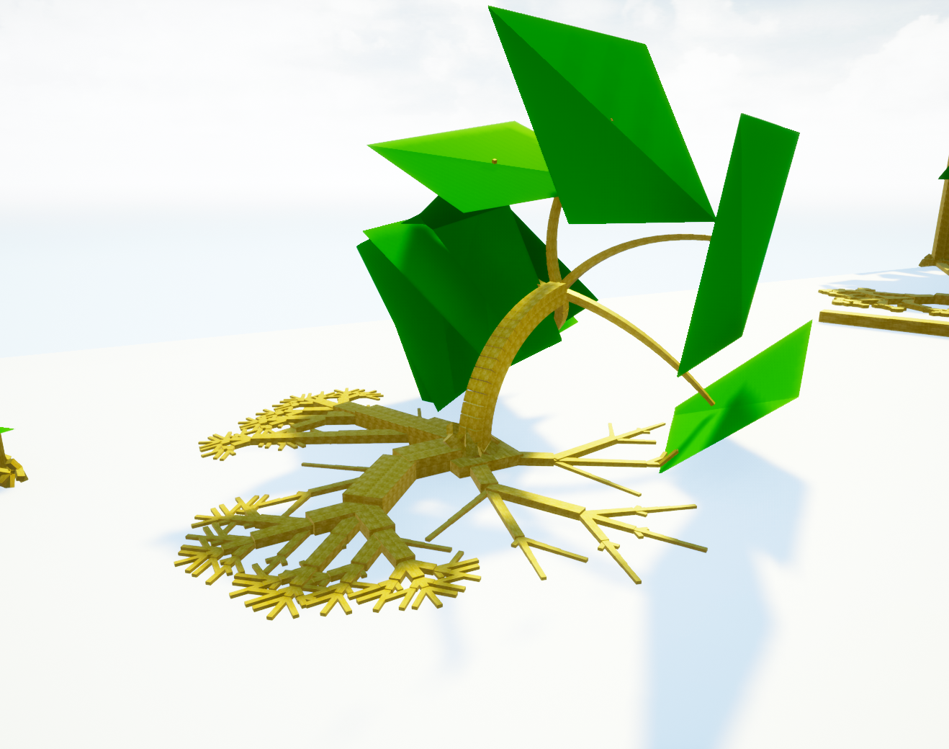
Fundamental Ideas
Plant grow modelled as deception
Grow works by attachement children
Etc
Etc

Slide 5
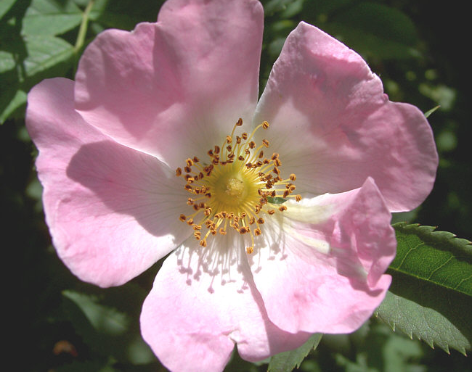
Dog Rose
Gleichverteilung
Etc
Etc

Slide 6

Baumwachstum als Selbstähnlichkeit
Baumwachstum lässt sich auch so beschreiben

Slide 7
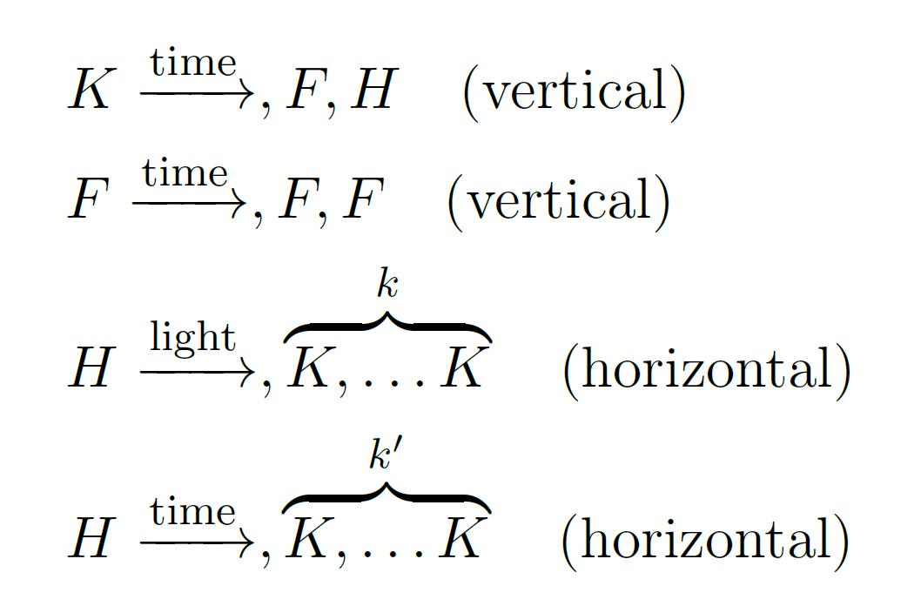
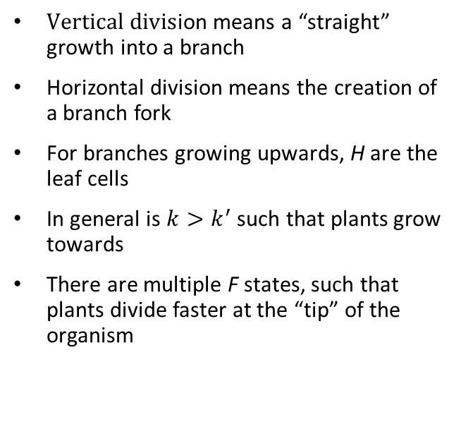
Division Rules
$\text{V}\text{ertical} \text{divis}$ion means a “straight” growth into a branch
Horizontal division means the creation of a branch fork
For branches growing upwards, H are the leaf cells
In general is $k>k^{′}$ such that plants grow towards
There are multiple F states, such that plants divide faster at the “tip” of the organism

Slide 8
Modelled Behaviors
Plants in water are allowed to have more cells
Wind destroys parts of plants that get hit by to much wind
Leafs that get hit by light divide faster and into more children
The diameter of cells grows when a higher „Weight“ rests on them
Growth can have a positive or negative correlation with gravity
Cell division into other cells or environment is forbidden by collision check
Certain cells (i.e. the roots) grow along the floor, or up walls

Slide 9
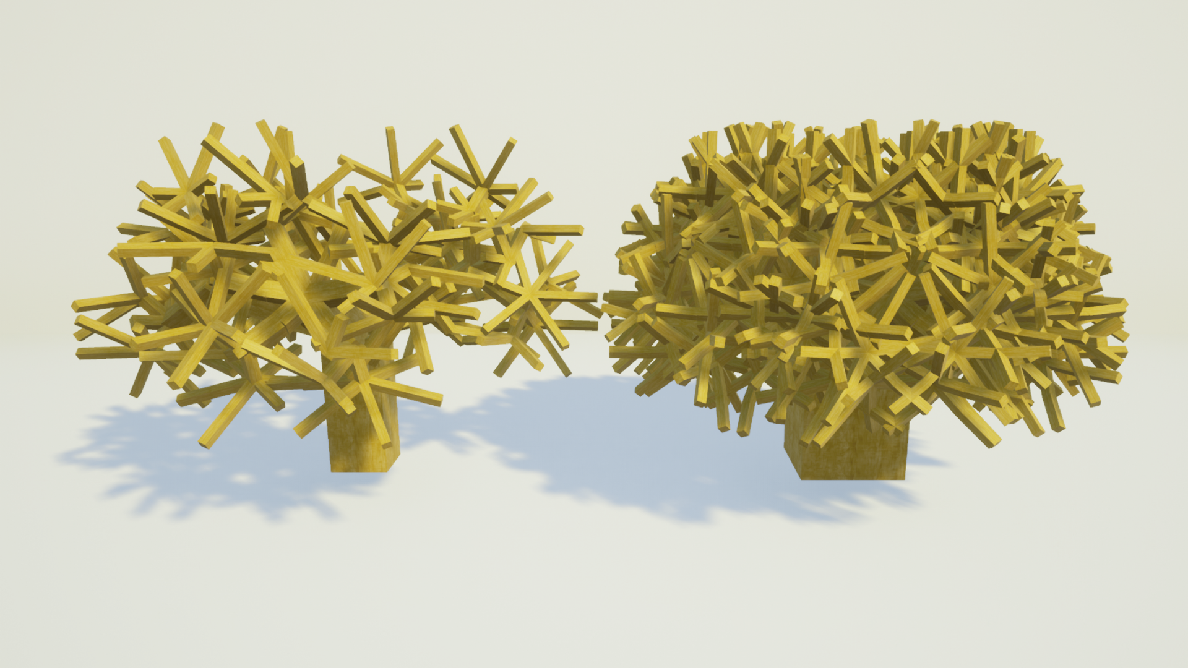
Self-Collision
Left: self-collision disabled; Right: Self-collision disabled

Slide 10
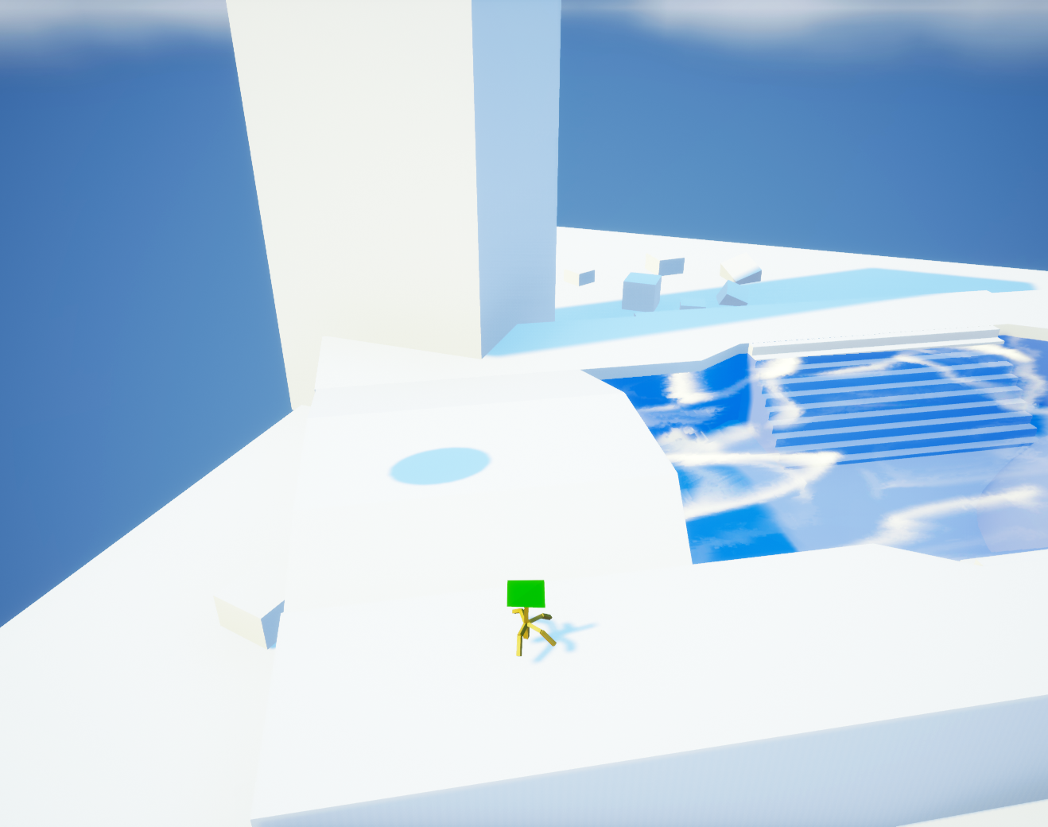
Plant Grow Example
5 Iterations

Slide 11
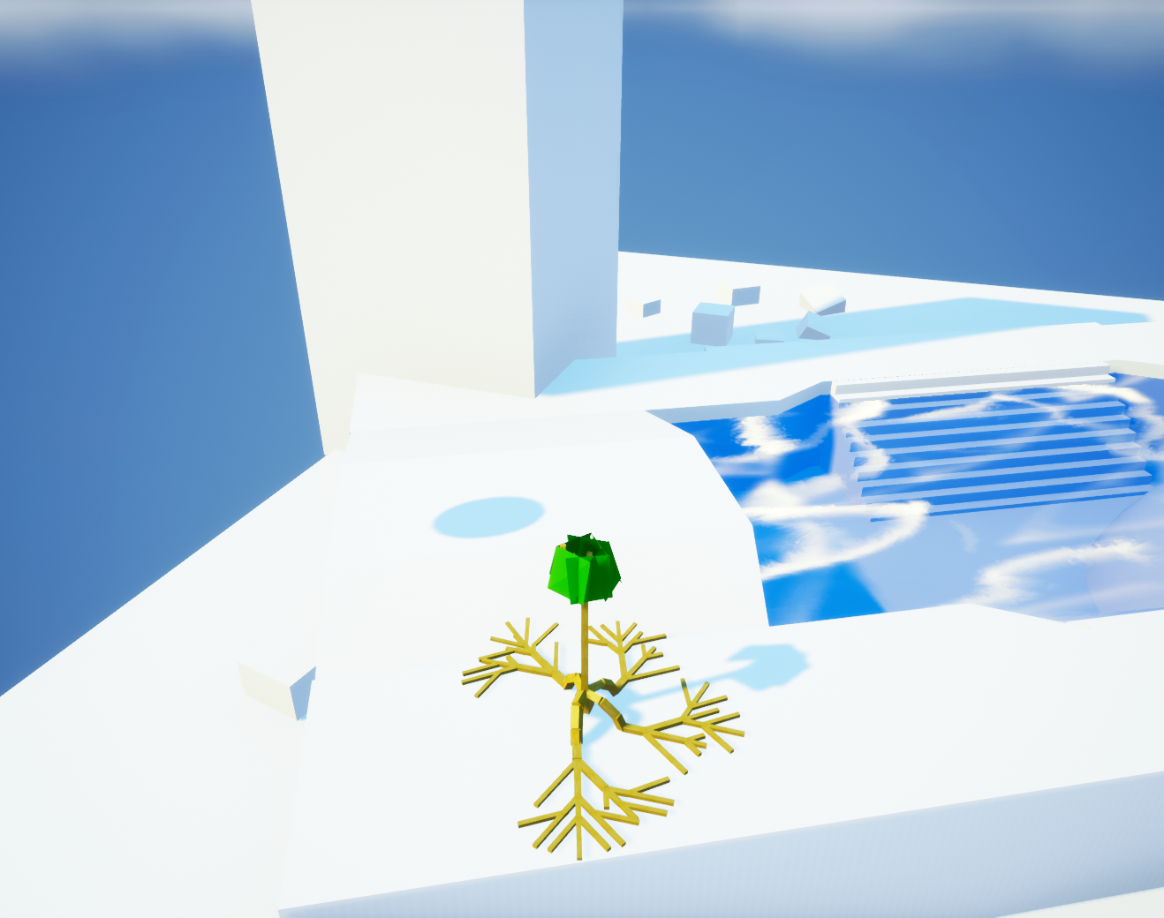
Plant Grow Example
20 Iterations

Slide 12
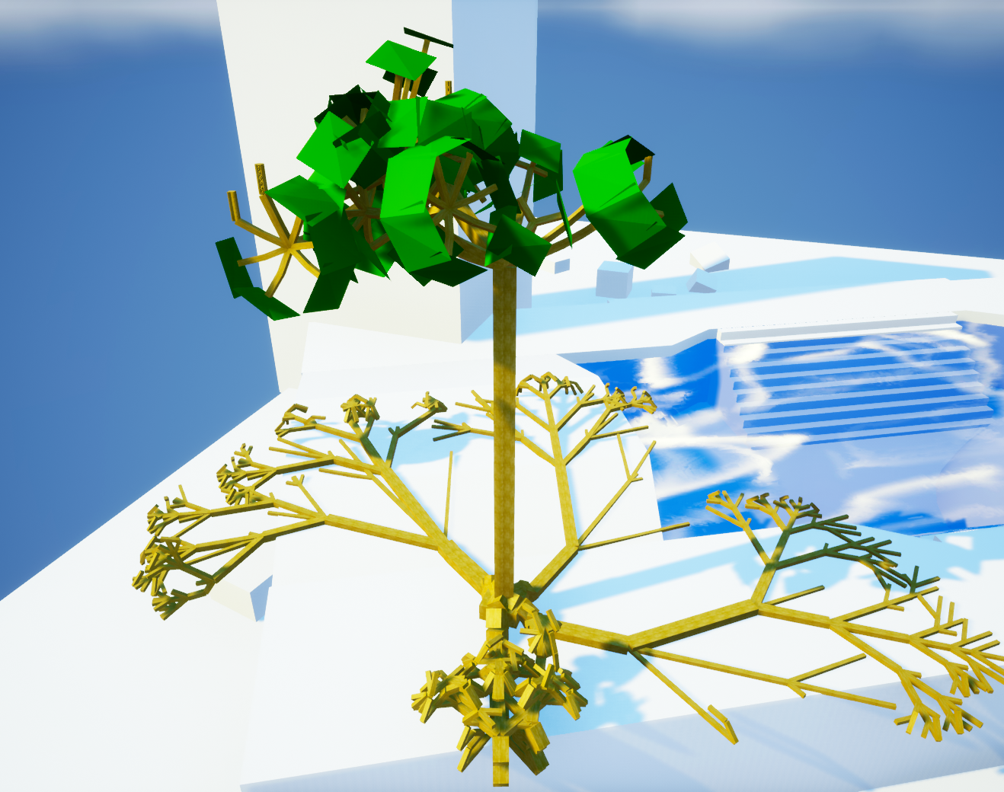
Plant Grow Example
35 Iterations

Slide 13
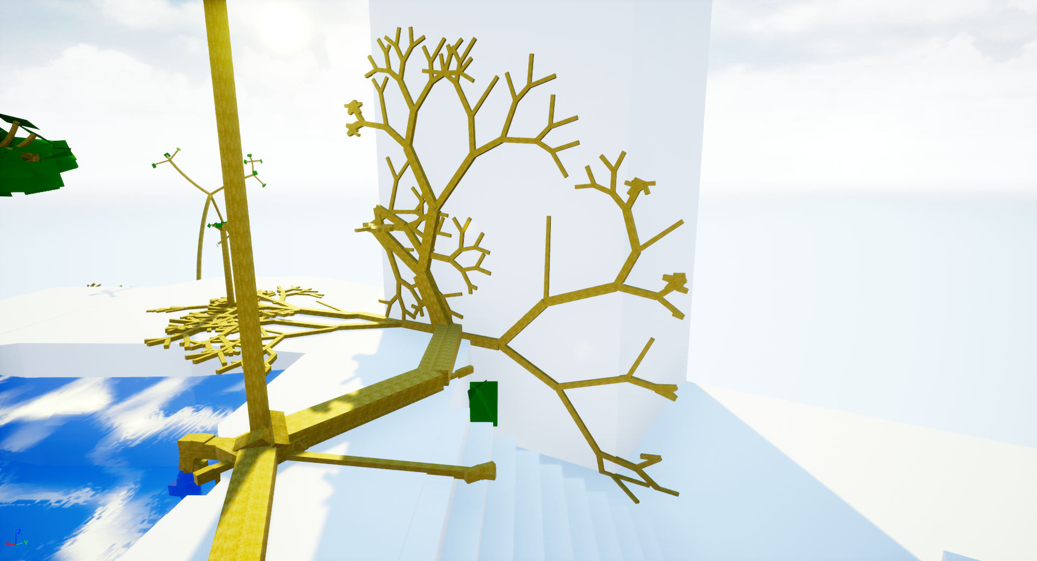
Growing Up Wall

Slide 14
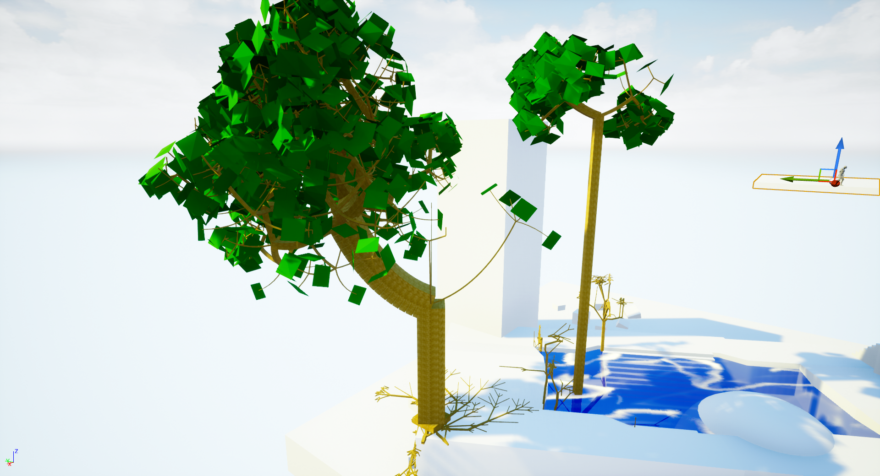
Grow to Light

Slide 15
Controls
WASD/mouse : movement
Space Jump / Fly
etc

Slide 16
Performance
Tabelle

Slide 17
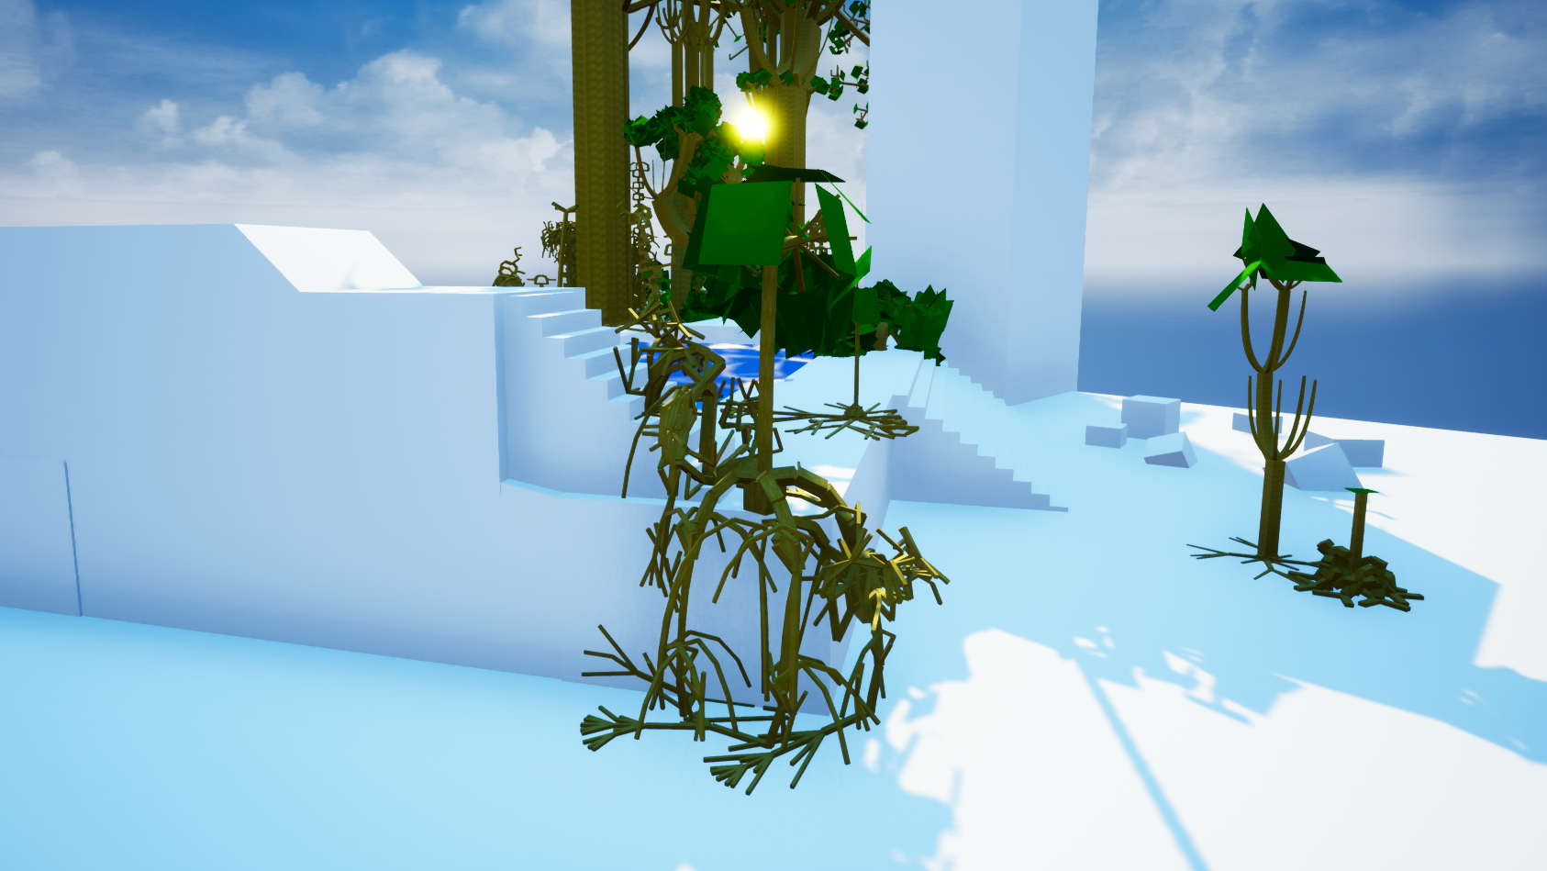
Growth down

Slide 18
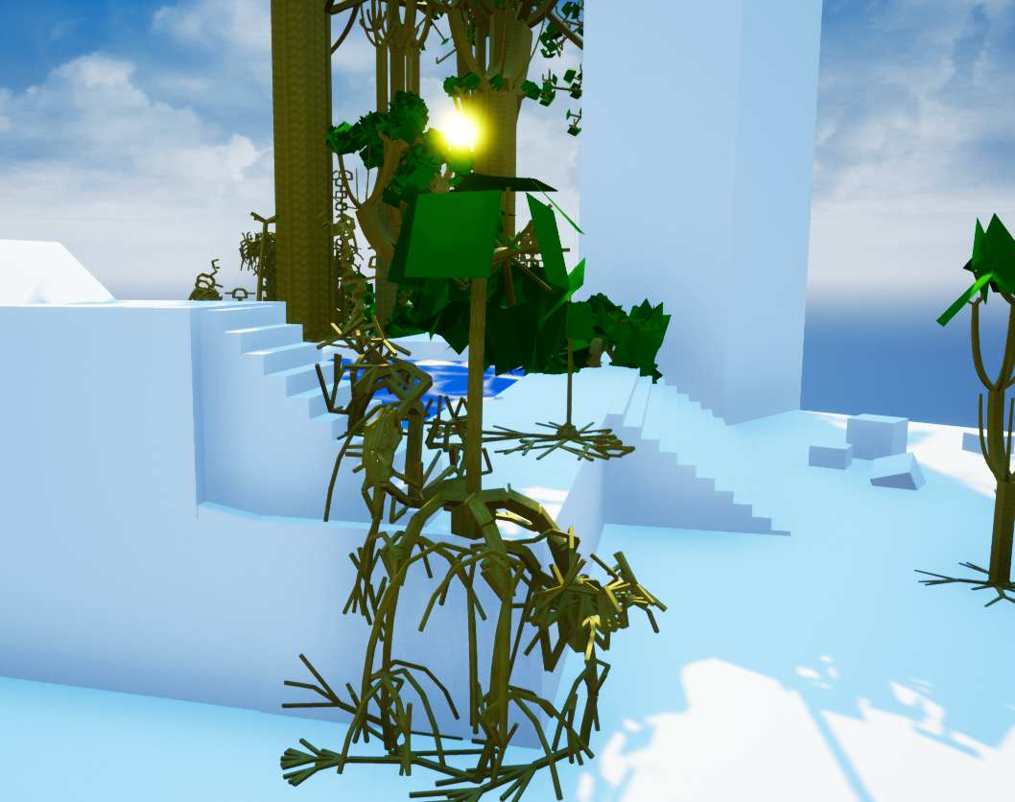
Roots Growing Down An Edge
Asdfasdf
Asdf
Asdf
Asdf
Asdf
asdf
asdf

Slide 19
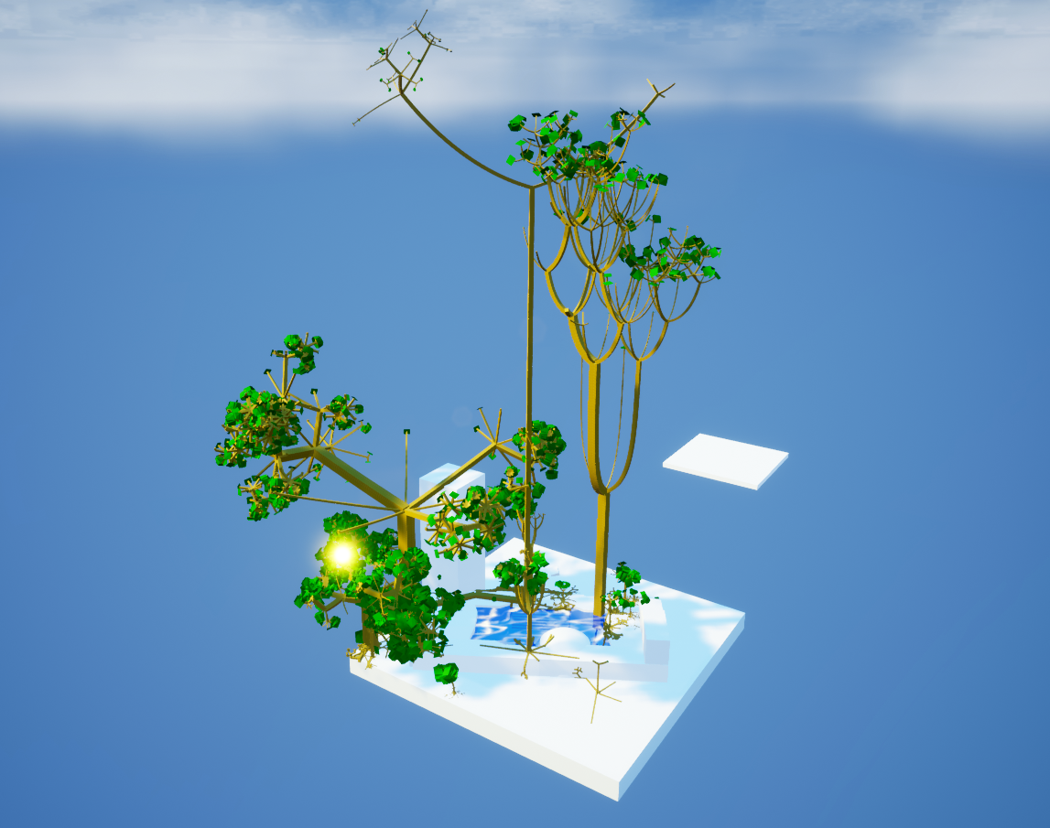
Results

Slide 20
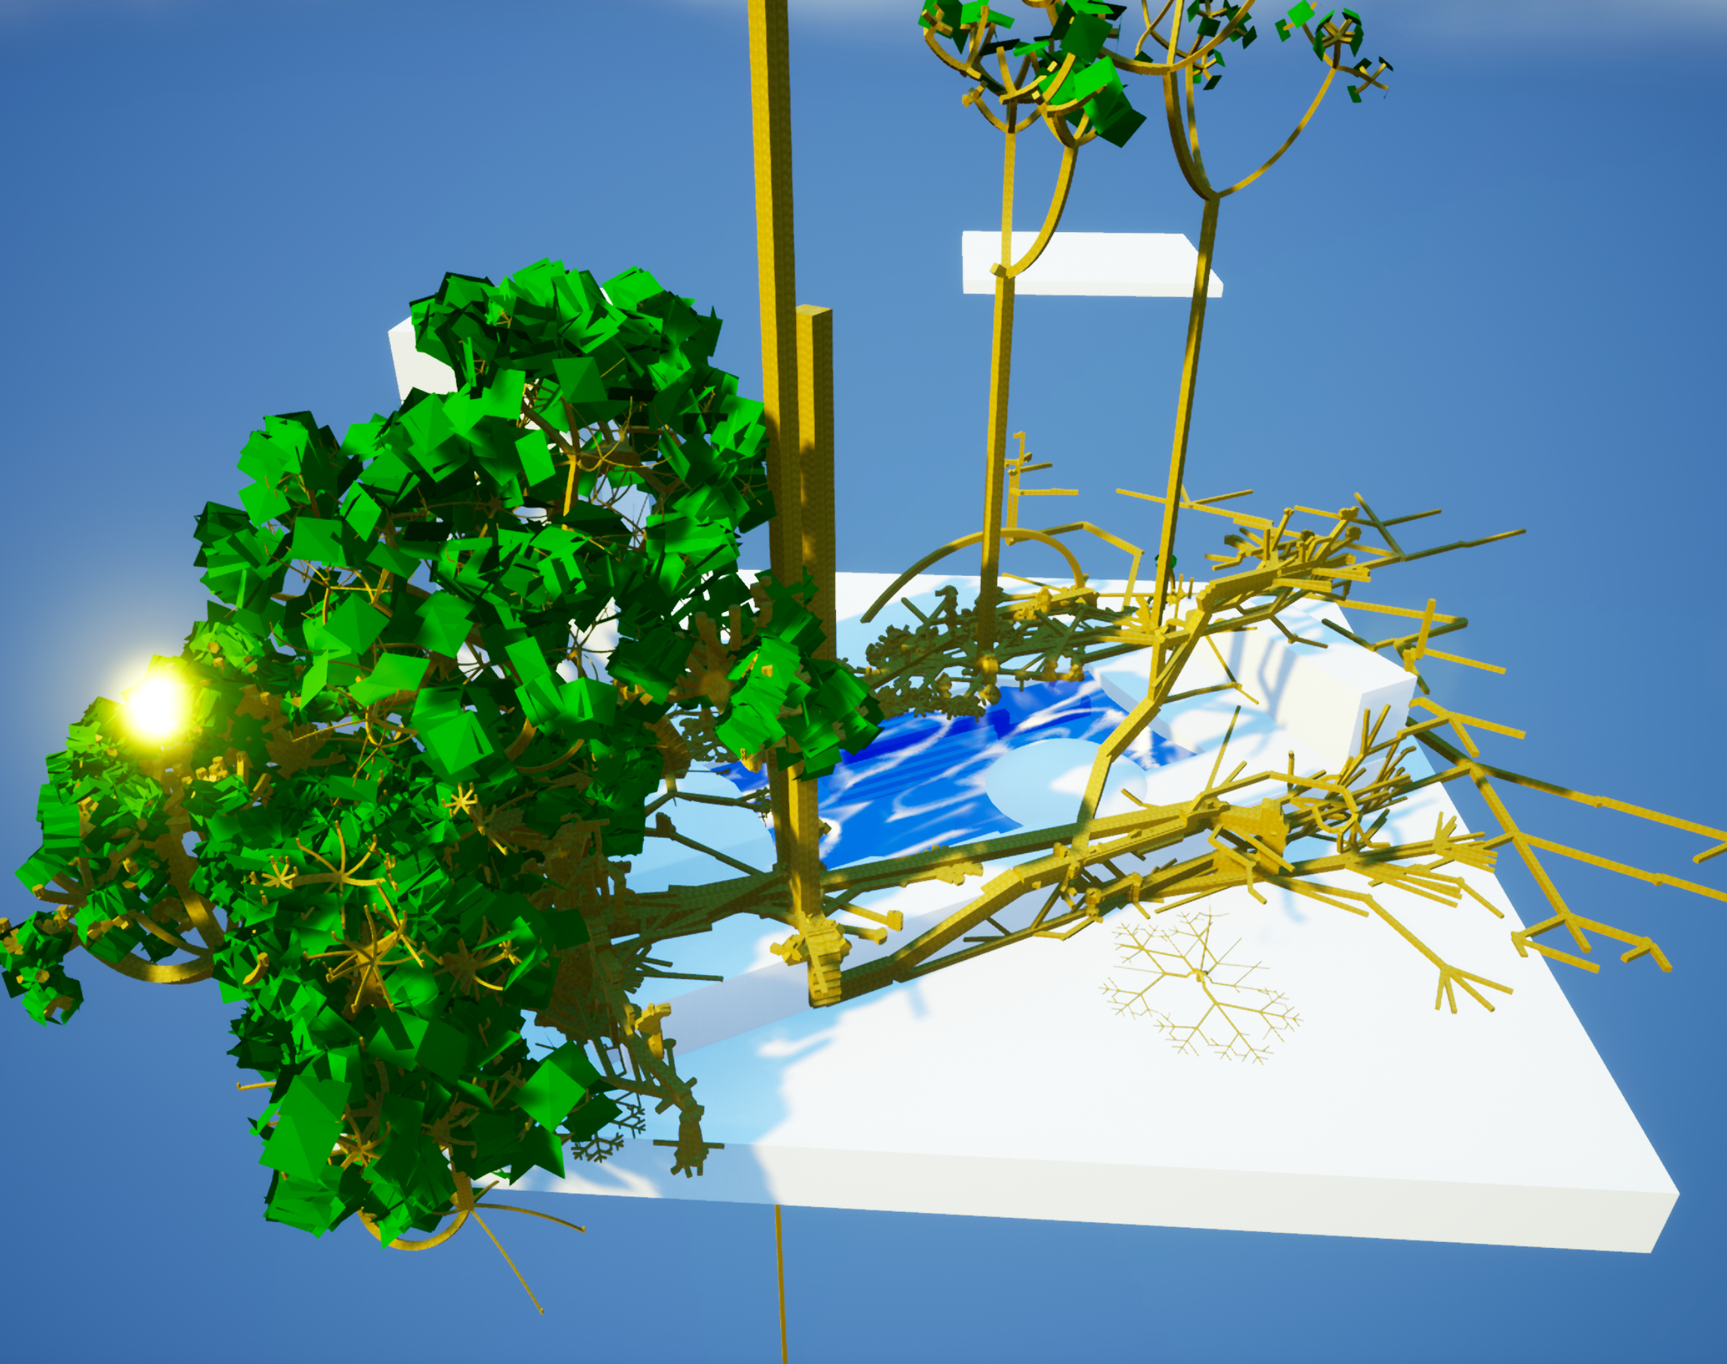

Slide 21
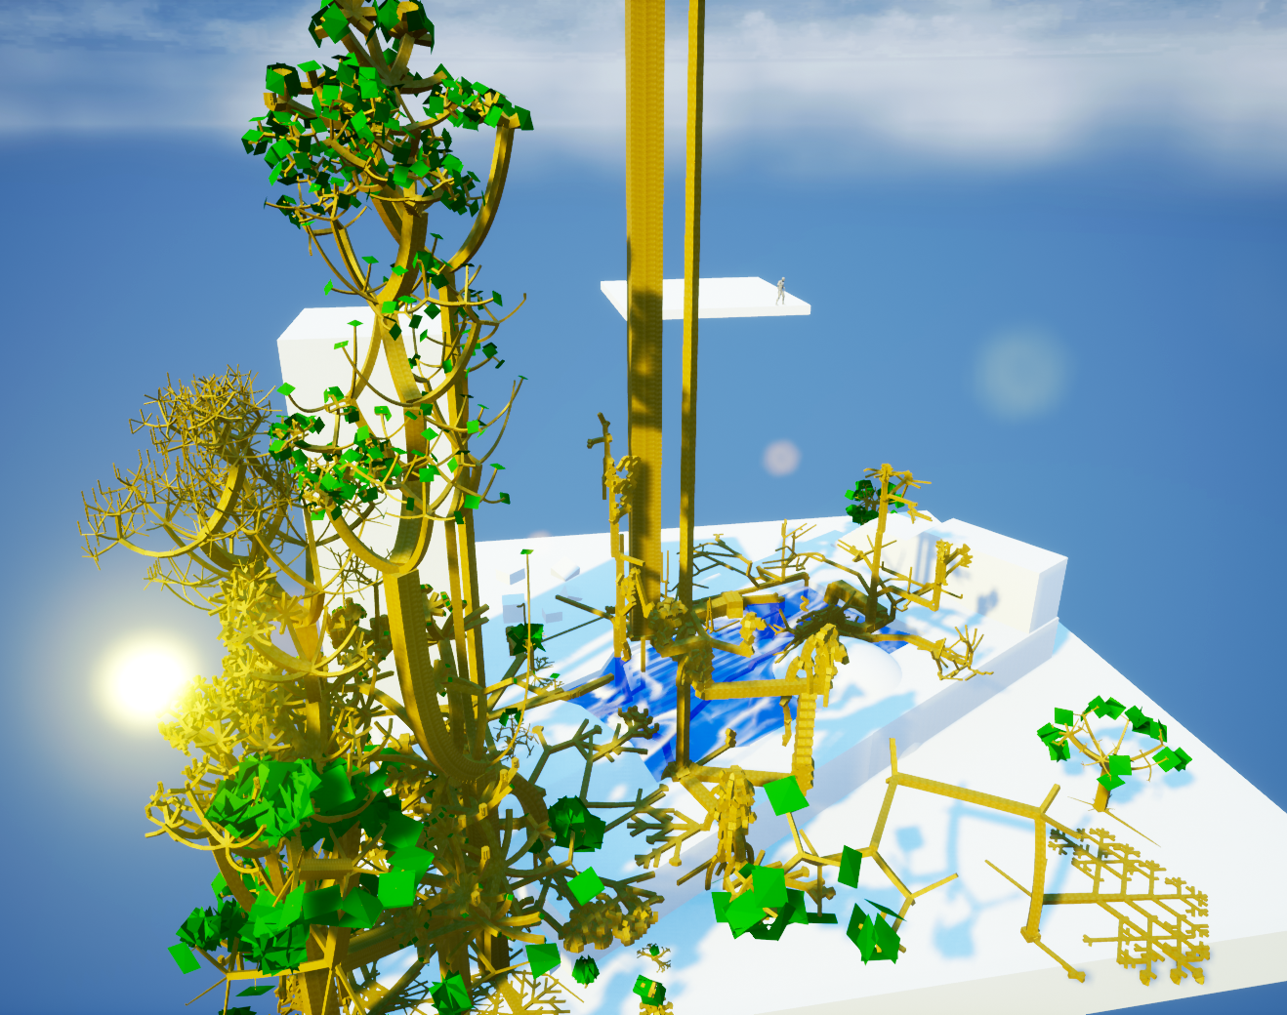
Results

